Slide 1
FILE ORGANIZER
BY
SUSINDHIRAN

Slide 2
INTRODUCTION
The digital age has led to an inevitable accumulation of files on our computers.
However, managing these files efficiently poses a significant challenge.
Disorganized files clutter storage space and complicate the process of locating specific documents.
This clutter hampers productivity and makes it challenging to access necessary files promptly.
Organizing files based on their types facilitates easier navigation and retrieval.
Users can quickly locate specific documents without the hassle of sorting through cluttered directories.

Slide 3
PURPOSE AND SIGNIFICANCE
The File Organizer project aims to streamline the process of managing files on computers.
It seeks to simplify the task of organizing files by automating the categorization process.
The project categorizes files into designated folders based on their file types.
This categorization ensures that files are organized in a systematic manner for easy retrieval.
Automation of the file organization process saves users significant time and effort.
Instead of manually sorting files, users can rely on the project to perform this task efficiently.

Slide 4
KEY FEATURES
Automatic Organization: The project utilizes Python scripting to automatically sort files based on their file extensions.
User-Friendly Interface: A graphical user interface (GUI) powered by Tkinter library facilitates easy interaction, allowing users to specify the folder location for file organization with just a few clicks.
Customizable Extension Mapping: Users have the flexibility to customize the categorization of files by defining their preferred file extensions and corresponding destination folders.

Slide 5
WORKFLOW OVERVIEW
Upon selecting a folder location through the GUI, the File Organizer script scans the directory for files.
For each file, it identifies its file extension and moves it to the appropriate folder based on a predefined mapping of file types to destination folders.
The mapping includes common file types such as images, documents, videos, audios, archives, executables, scripts, and others.
Files with unknown extensions are placed in a default "Others" folder.

Slide 6
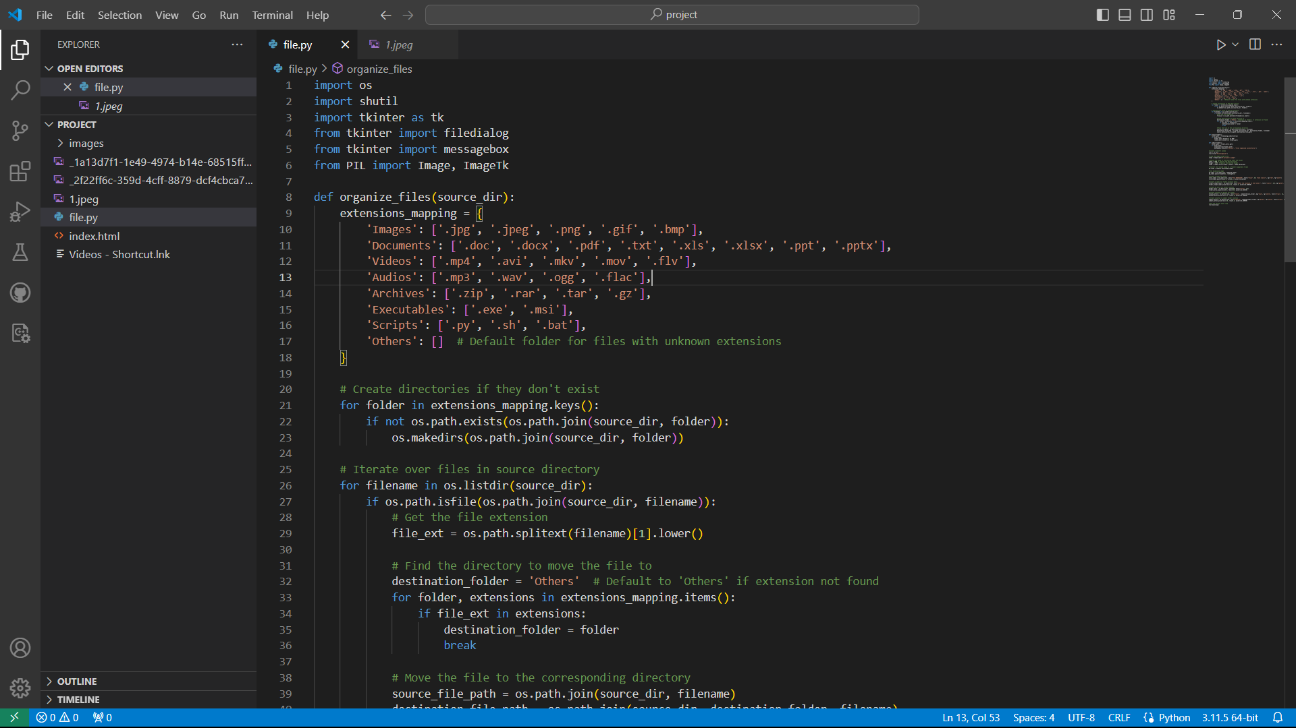
CODE IMPLEMENTATION

Slide 7
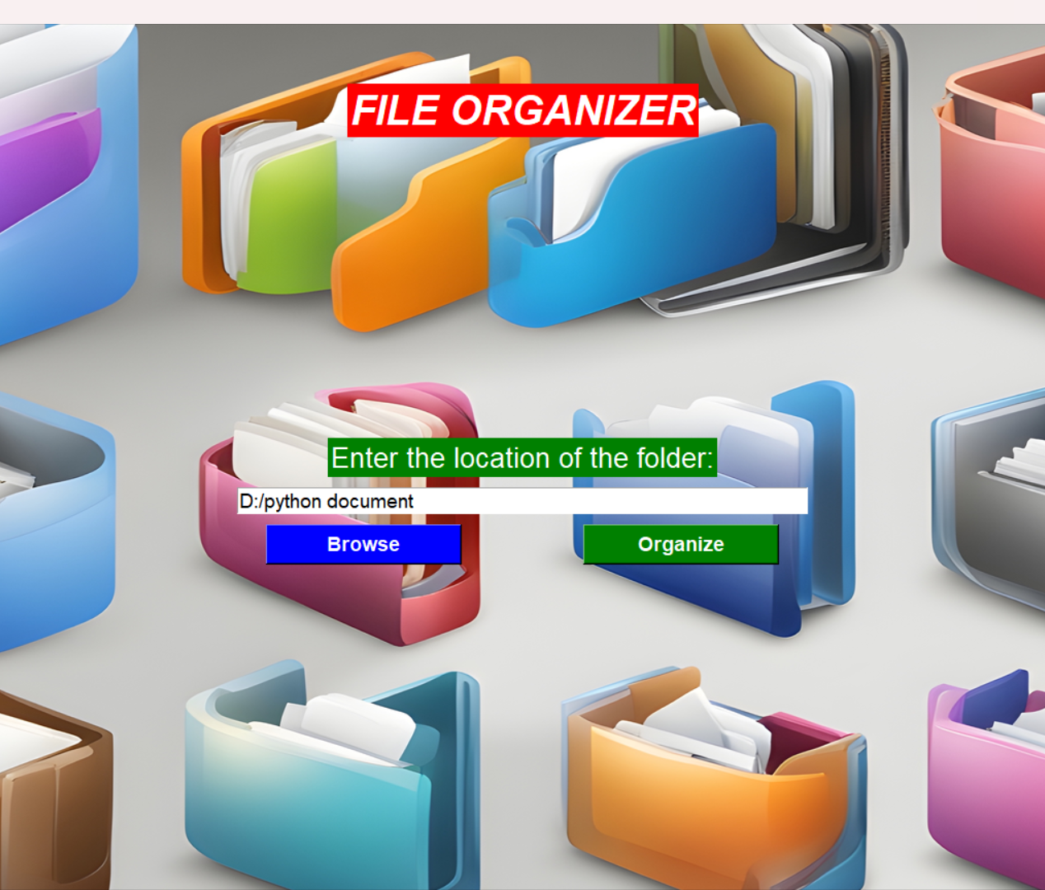
USER INTERFACE
The organized file system created by the project enhances user convenience.
Users can quickly find the files they need, improving overall workflow efficiency.

Slide 8
CONCLUSION
The File Organizer project provides a comprehensive solution to the challenges of file management in the digital age.
By automating the organization process based on file types, it simplifies the task of managing files on computers.
The project features a user-friendly interface powered by the Tkinter library, ensuring intuitive interaction for users of all levels.
The project offers a practical solution for individuals and organizations seeking to optimize their file management practices.

